Slide 1

E commerce website management system
PRESENTATION

Slide 2

NAME OF TEAMMATES
ABBASS HYDER(BSE-23F-100)
M.HUNAIN (BSE-23F-064)
MOHIB A.SAMAD(BSE-23F-090)
HASHIR HASSAN(BSE-23F-056)

Slide 3
What is e-commerce ?
.
Commonly known as Electronic – marketing.
It consists selling and buying goods and services over an electronic system such as internet and other computer network.
E-commerce is the purchasing, selling and exchanging goods and services over computer networks.

Slide 4
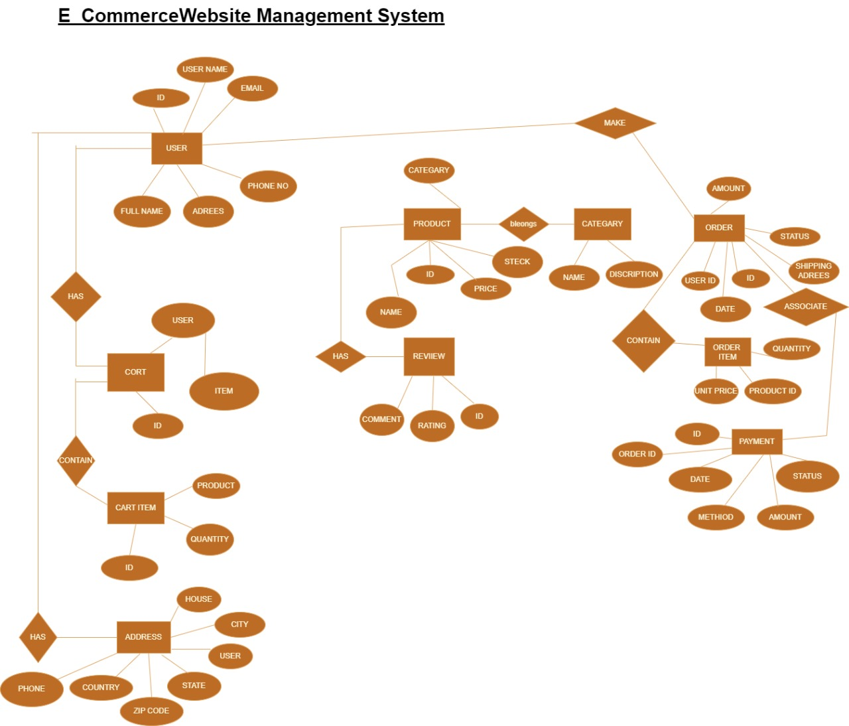
ER-MODEL
E-COMMERCE WEBSITE
DEFINATION OF ER-MODEL?
An Entity-Relationship (ER) model in a Database Management System (DBMS) is a conceptual framework used to describe the structure of a database. It visually represents the data and their interrelationships through entities, attributes, and relationships, providing a clear and systematic way to define data requirements and organize data within a database. Key Components of an ER-Model. 1. Entities: Objects or things in the real world with an independent existence. For example, Student, Course, and Instructor. 2. Attributes: Properties or characteristics of entities. For example, a Student entity might have attributes such as Student ID, Name, and Date Of Birth.

Slide 5
CONTRIBUTION OF EACH PARTNER
QUERIES: MOHIB ABDUL SAMAD, M.HUNAIN
PRESENTATION: ABBAS HYDER
ER MODEL: HASHIR HASSAN

Slide 6
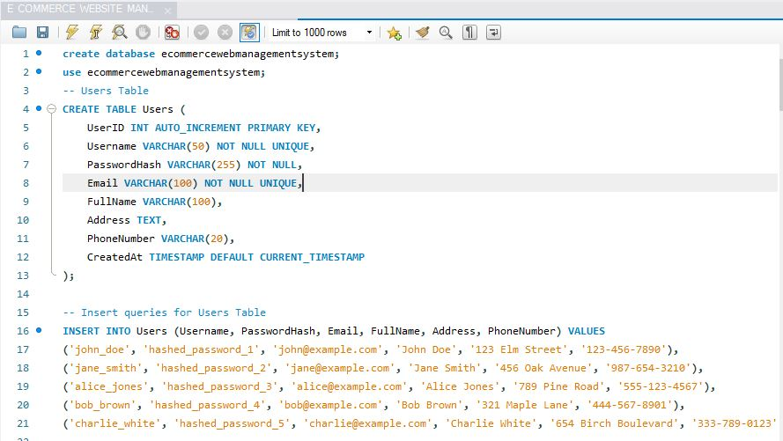
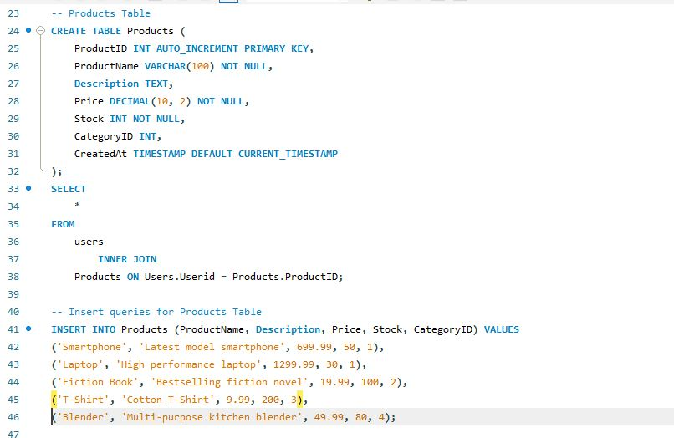
SQL QUERY

Slide 7
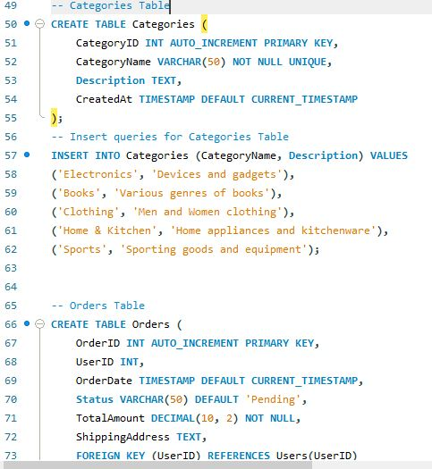
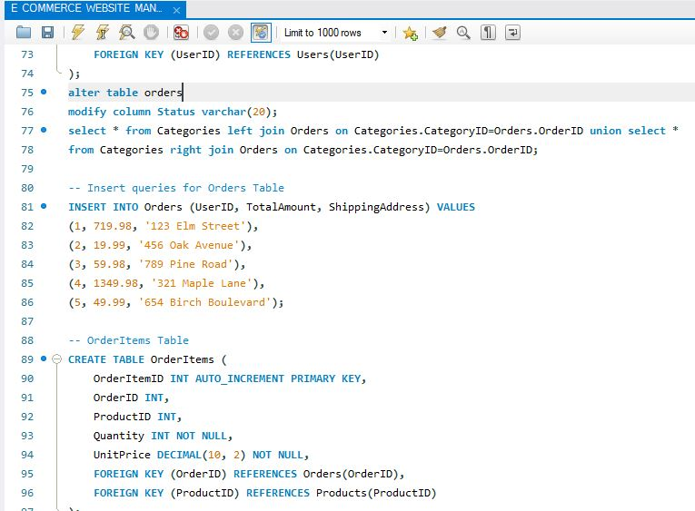
SQL QUERY

Slide 8
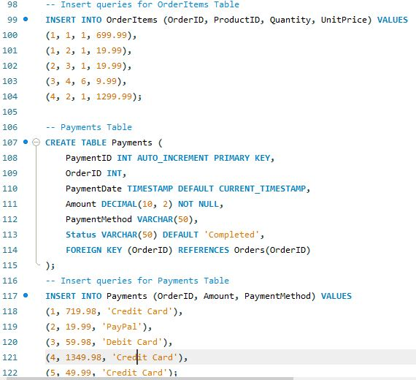
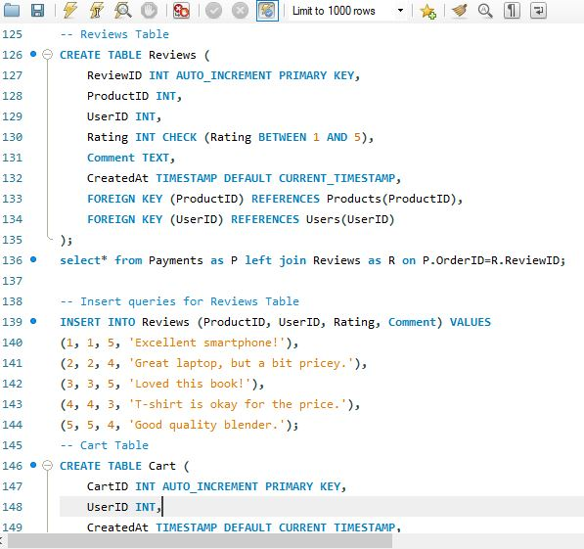
SQL QUERY

Slide 9
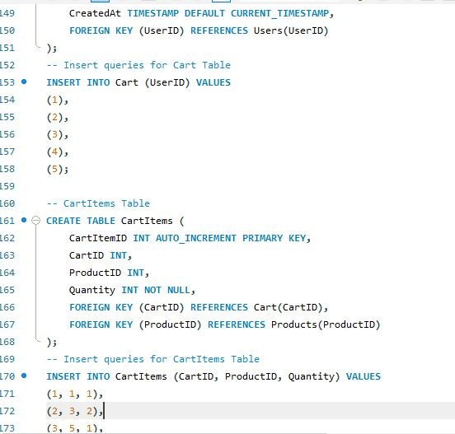
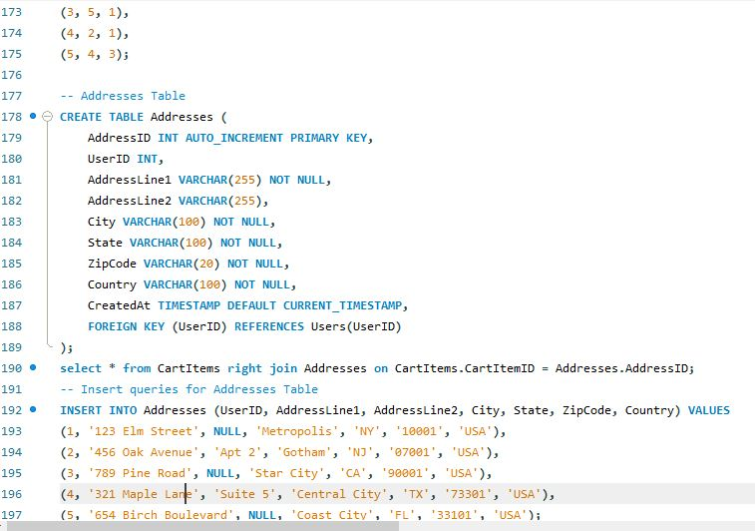
SQL QUERY

Slide 10
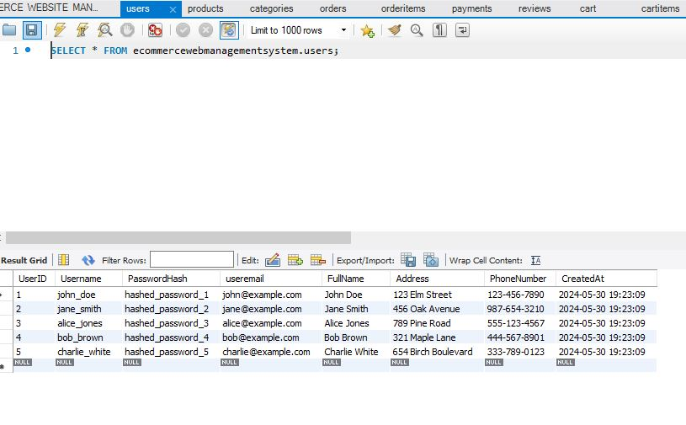
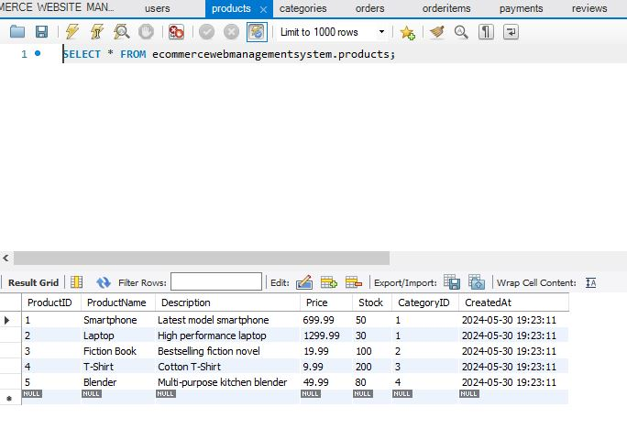
TABLES

Slide 11
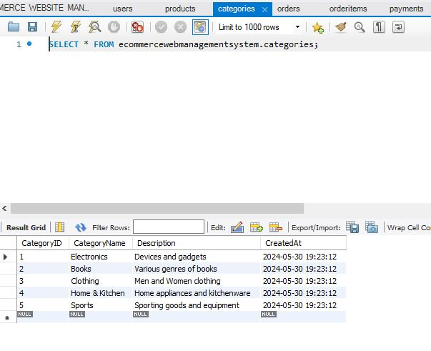
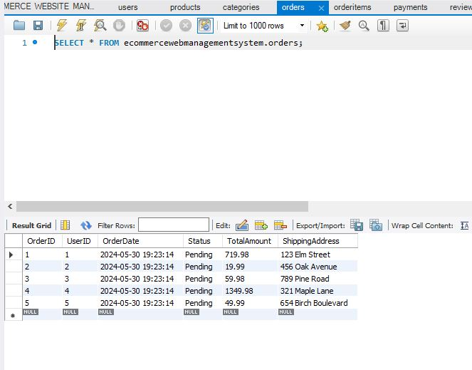
TABLES

Slide 12
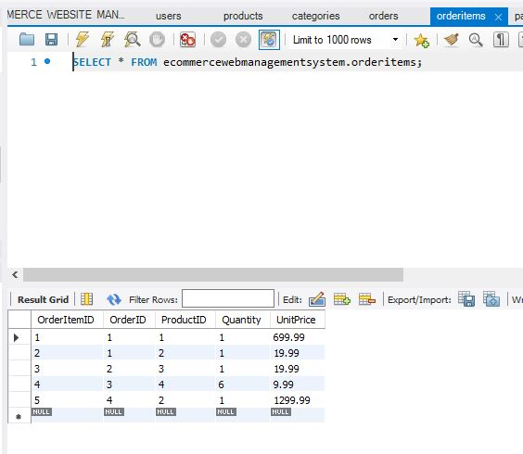
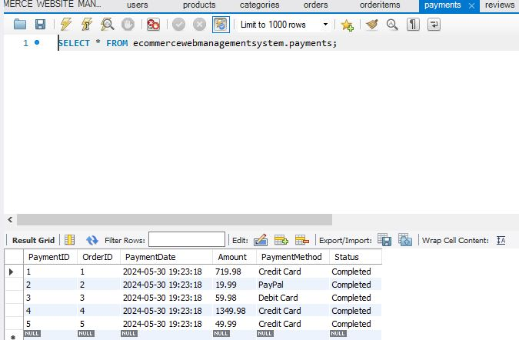
TABLES

Slide 13
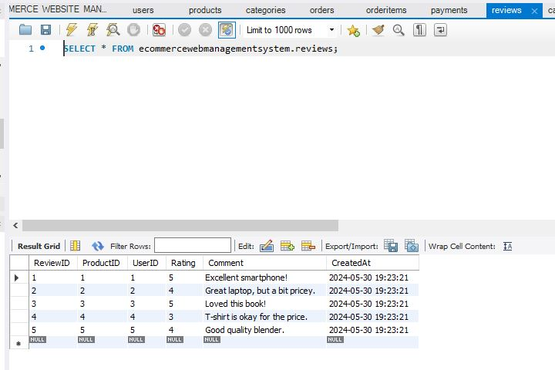
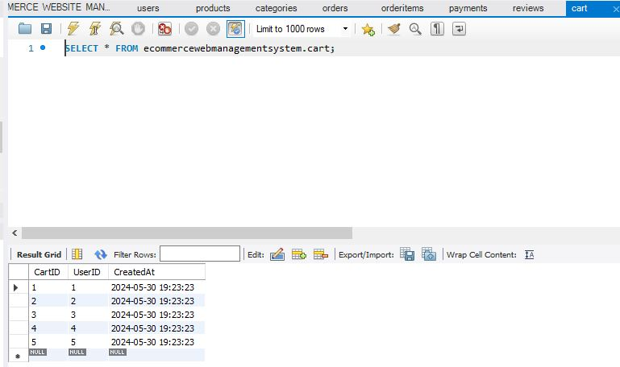
TABLES

Slide 14
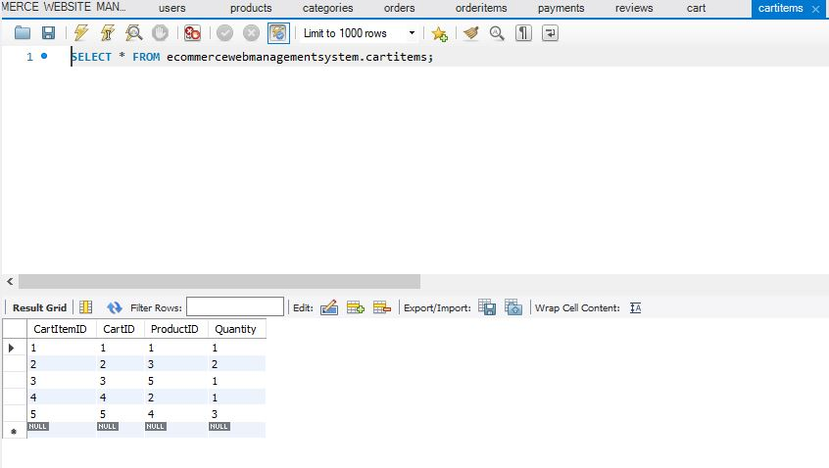
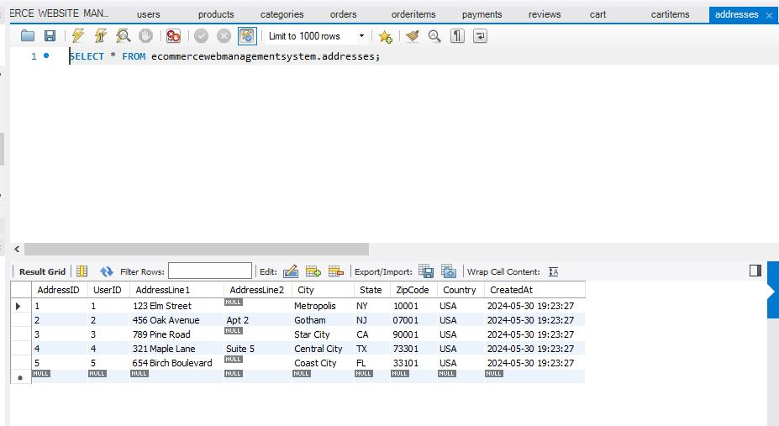
TABLES

Slide 15
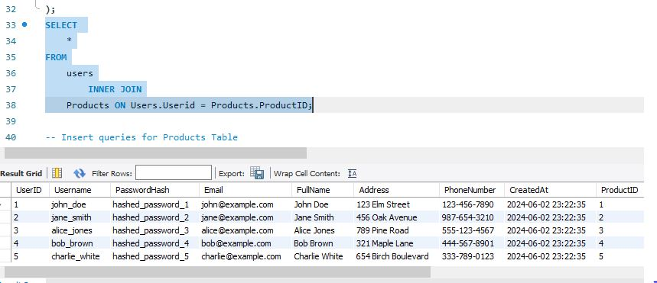
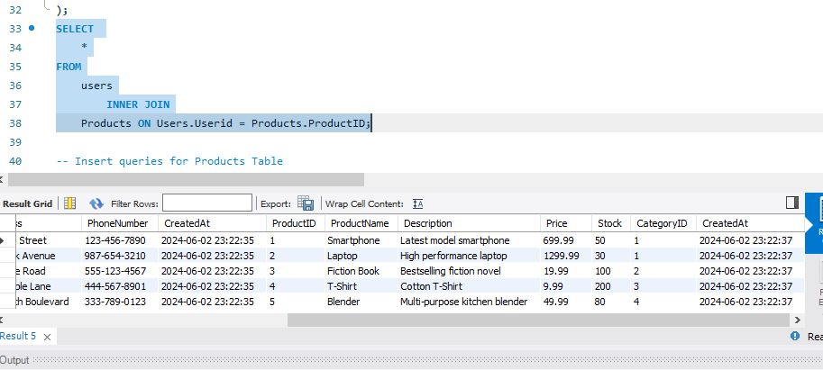
SQL QUERY

Slide 16
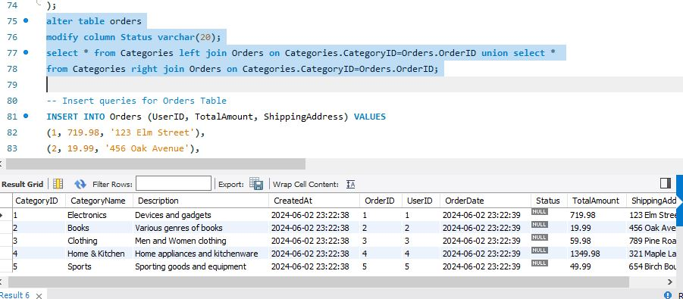
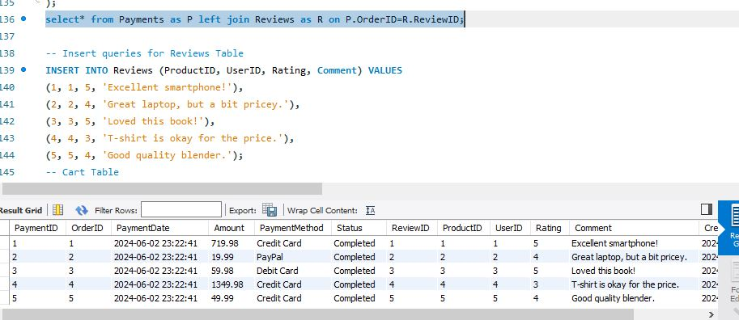
SQL QUERY

Slide 17
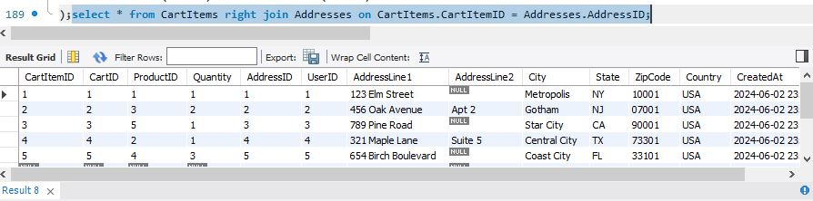
SQL QUERY

Slide 18
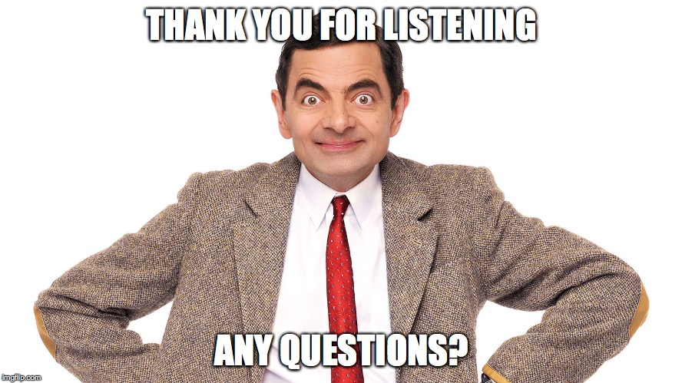
THANK YOU

